Slide 1


















Slide 2
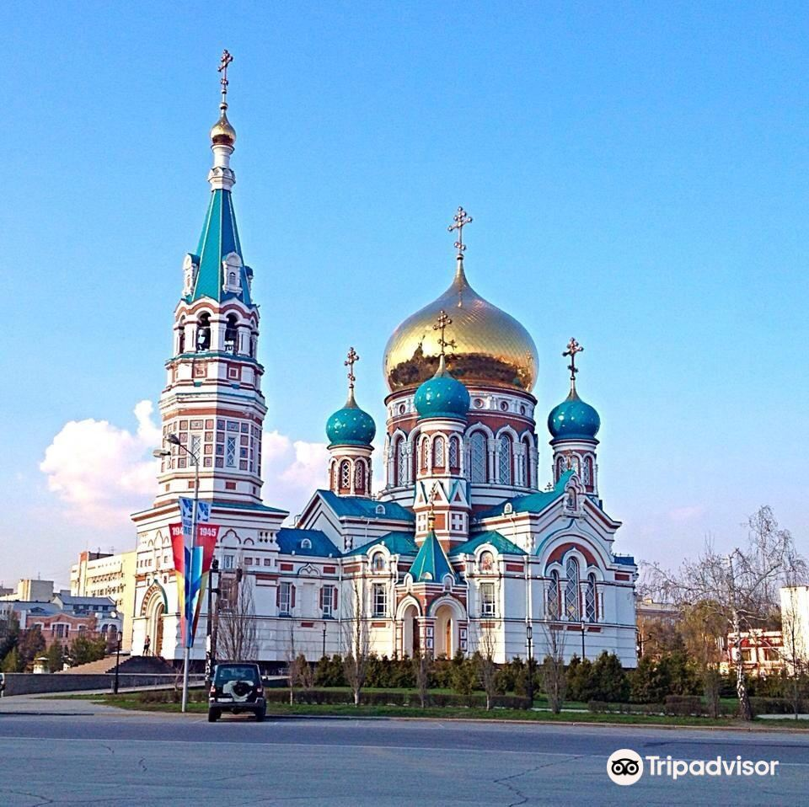
DEAR
From

Slide 3

DEAR
From

Slide 4
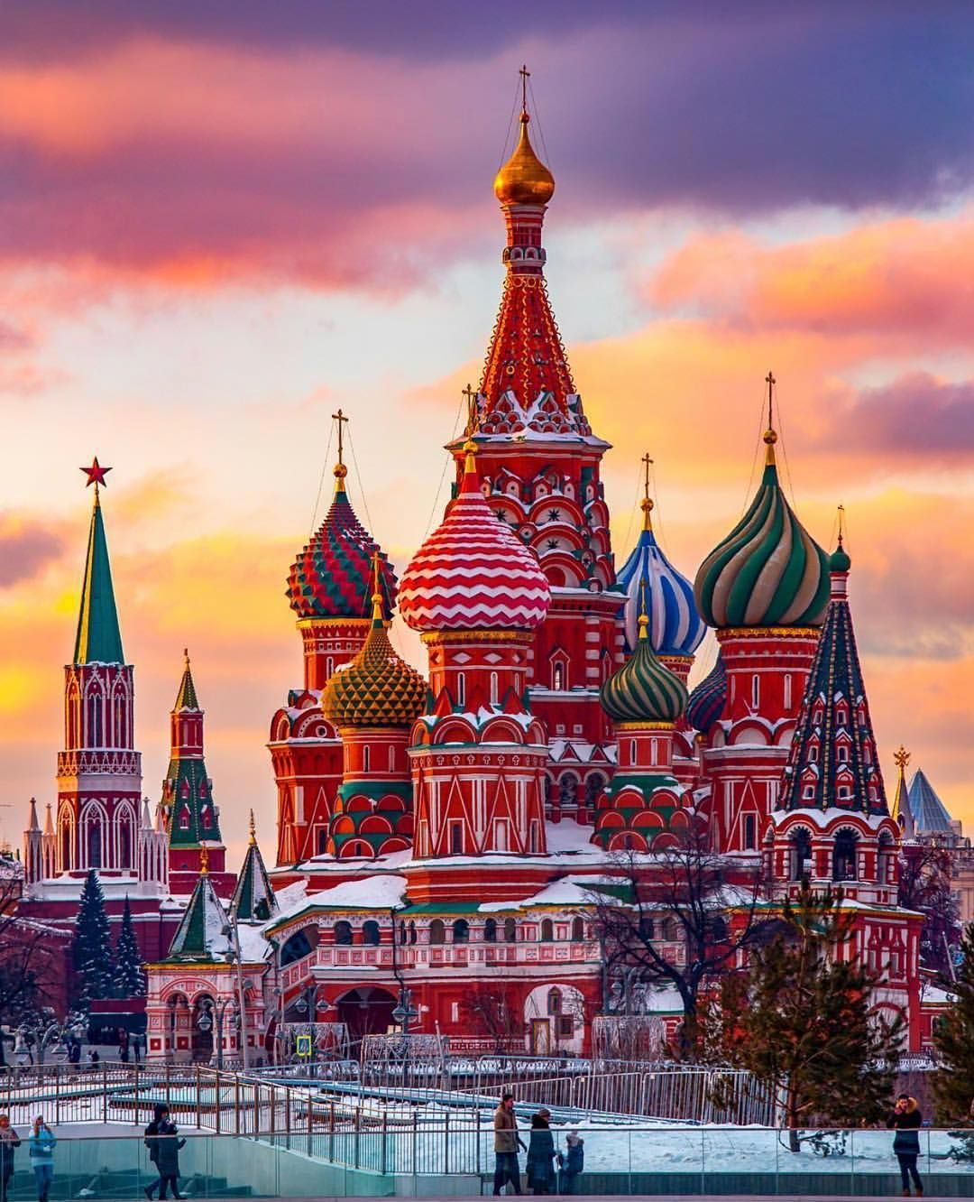
DEAR
From

Slide 5

DEAR
From

Slide 6

DEAR
From

Slide 7
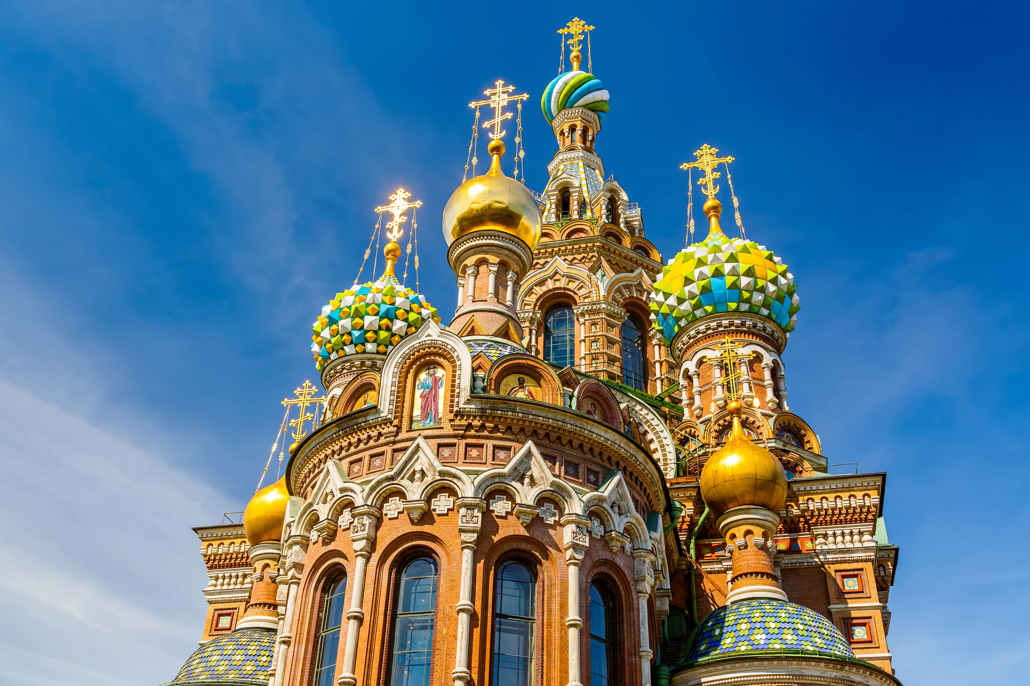
DEAR
From

Slide 8
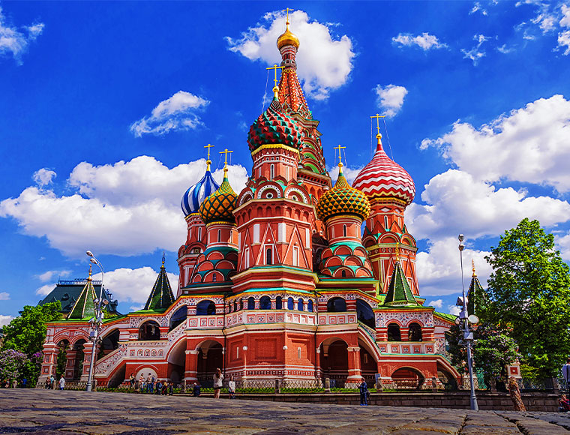
DEAR
From

Slide 9
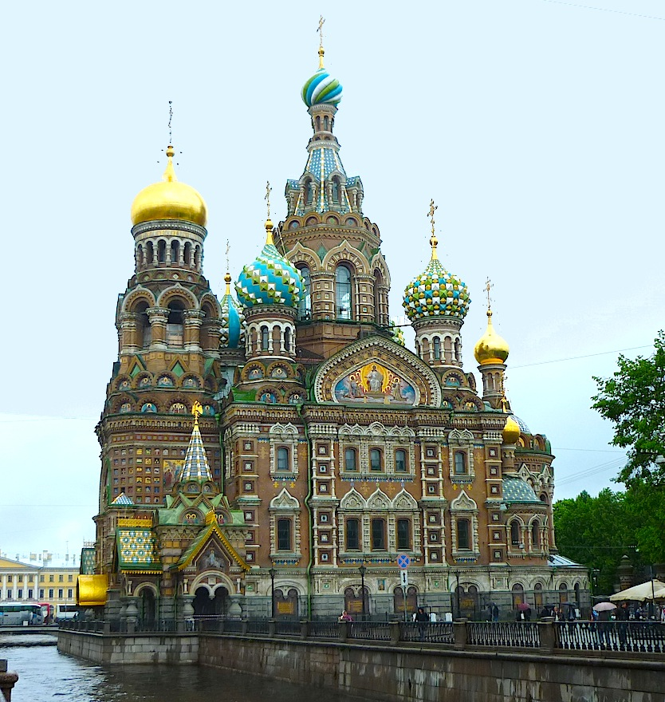
DEAR
From

Slide 10
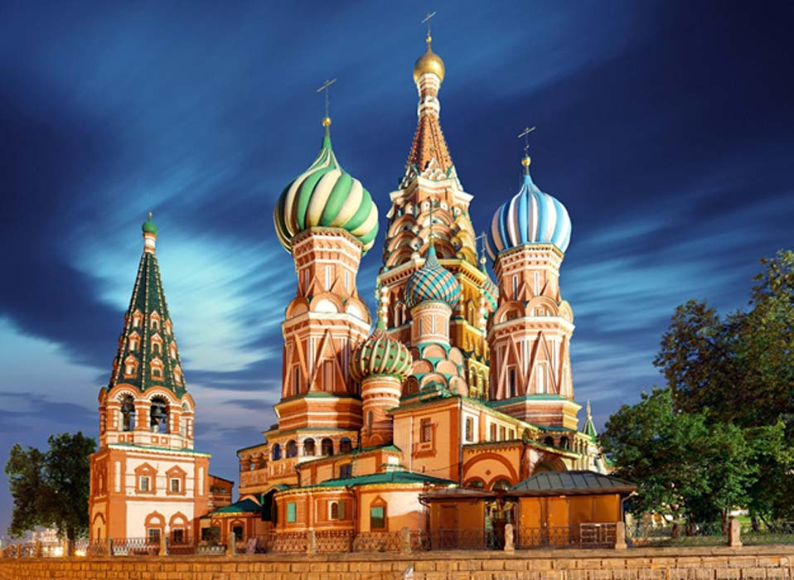
DEAR
From

Slide 11

DEAR
From

Slide 12

Dear
From

Slide 13

Dear
From

Slide 14

Dear
From

Slide 15

Dear
From

Slide 16

Dear
From

Slide 17

Dear
From

Slide 18
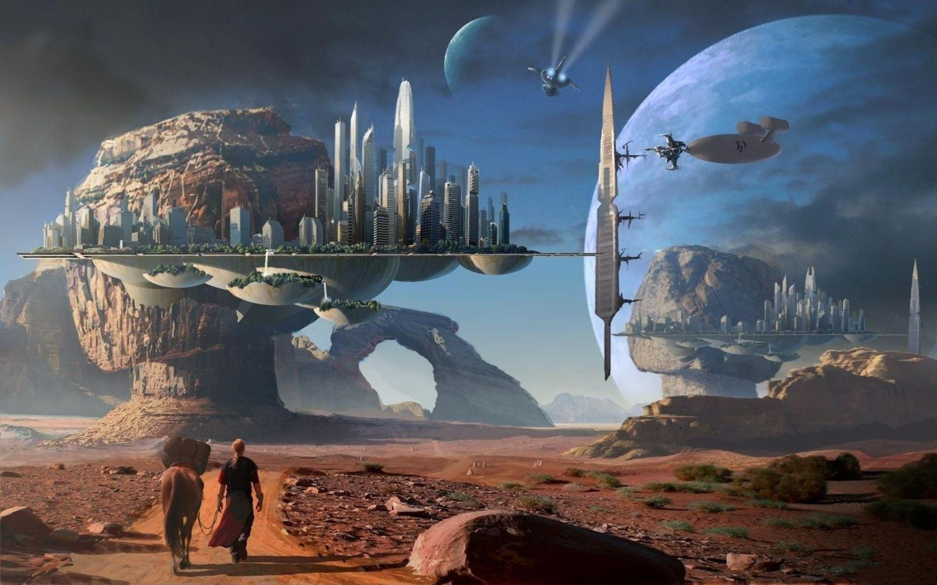
Dear
From

Slide 19

Dear
From

Slide 20

Dear
From

Slide 21

Dear
From

Slide 22
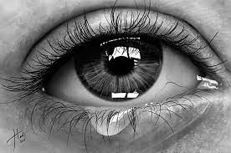
Dear
From

Slide 23

Dear
From

Slide 24

Dear
From

Slide 25

Dear
From

Slide 26
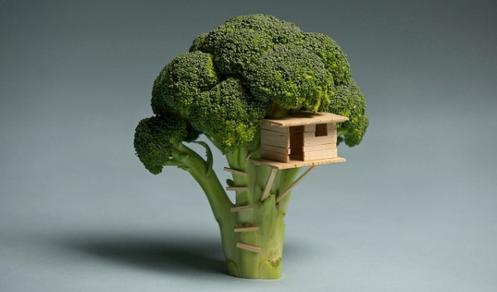
Dear
From

Slide 27

Dear
From

Slide 28

Dear
From

Slide 29

Dear
From

Slide 30

Dear
From

Slide 31

Dear
From

Slide 32

Dear
From

Slide 33

Dear
From

Slide 34

Dear
From

Slide 35

Dear
From

Slide 36

Dear
From

Slide 37

Dear
From

Slide 38

Dear
From

Slide 39

Dear
From

Slide 40
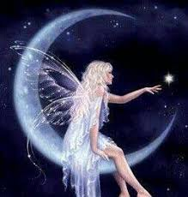
Dear
From

Slide 41

Dear
From

Slide 42

Dear
From

Slide 43
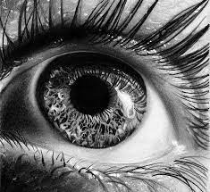
Dear
From

Slide 44
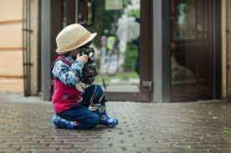

Dear
Dear
From
From

Slide 45

Dear
From

Slide 46

Dear
From

Slide 47

Dear
From

Slide 48


Dear
Dear
From
From

Slide 49
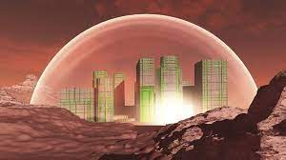

Dear
Dear
From
From

Slide 50

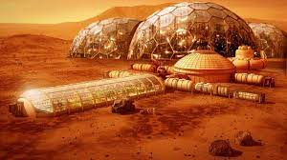
Dear
Dear
From
From

Slide 51


Dear
Dear
From
From

Slide 52

Dear
From

Slide 53

Dear
From

Slide 54


Dear
Dear
From
From

Slide 55


Dear
Dear
From
From

Slide 56


Dear
Dear
From
From

Slide 57

Dear
From

Slide 58


Dear
Dear
From
From

Slide 59

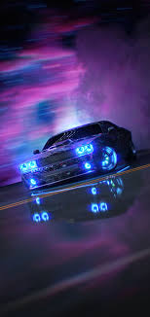
Dear
Dear
From
From

Slide 60


Dear
Dear
From
From

Slide 61


Dear
Dear
From
From

Slide 62


Dear
Dear
From
From

Slide 63



Dear
Dear
Dear
From
From
From

Slide 64

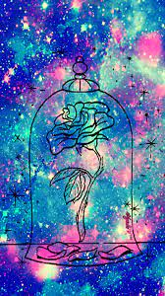

Dear
Dear
Dear
From
From
From

Slide 65



Dear
Dear
Dear
From
From
From

Slide 66


Dear
Dear
From
From

Slide 67


Dear
Dear
From
From

Slide 68


Dear
Dear
From
From

Slide 69

Dear
From

Slide 70

Dear
From

Slide 71

Dear
From

Slide 72

Dear
From

Slide 73

Dear
From

Slide 74

Dear
From

Slide 75

Dear
From

Slide 76

Dear
From

Slide 77

Dear
From

Slide 78

Dear
From

Slide 79

Dear
From

Slide 80


Dear
Dear
From
From

Slide 81

Dear
From

Slide 82

Dear
From

Slide 83

Dear
From

Slide 84
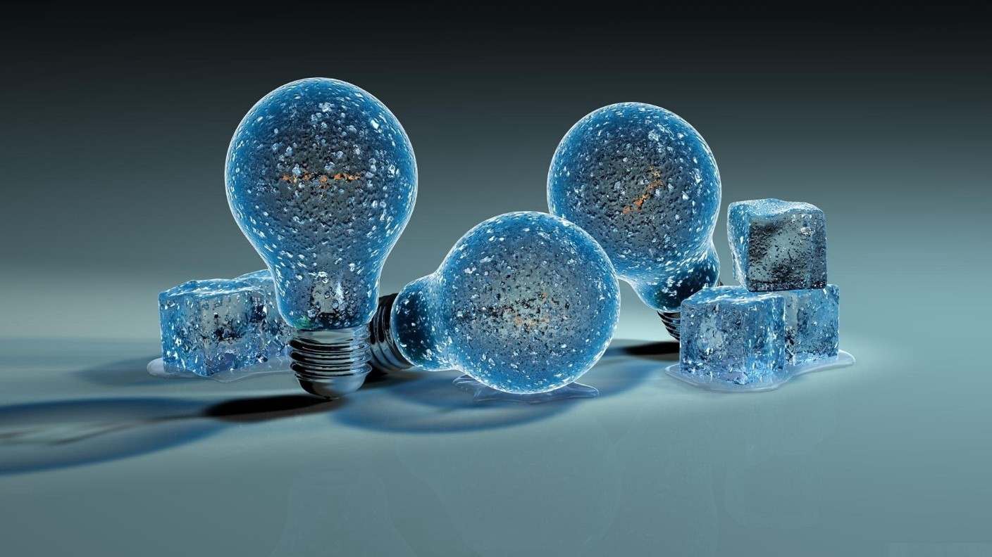
Dear
From

Slide 85

Dear
From

Slide 86

Dear
From

Slide 87

Dear
From

Slide 88


Dear
Dear
From
From

Slide 89
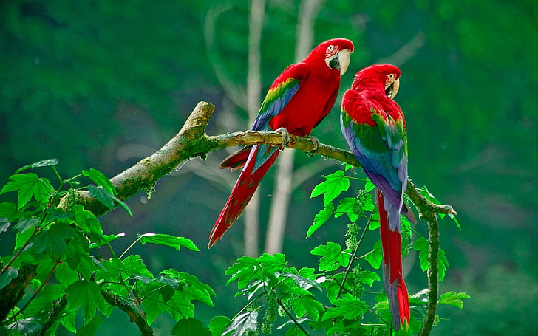
Dear
From

Slide 90
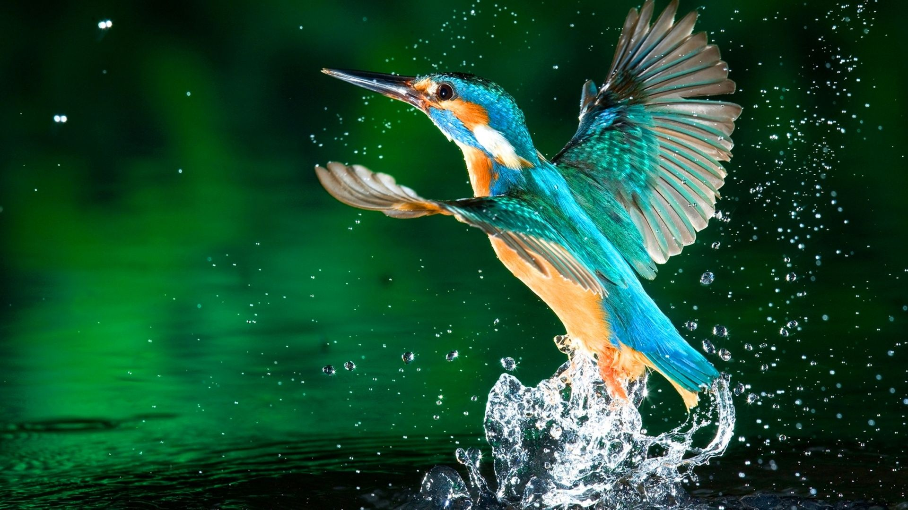
Dear
From

Slide 91

Dear
From

Slide 92

Dear
From

Slide 93

Dear
From

Slide 94


Dear
Dear
From
From

Slide 95

Dear
His
Her
From

Slide 96

Dear
From

Slide 97
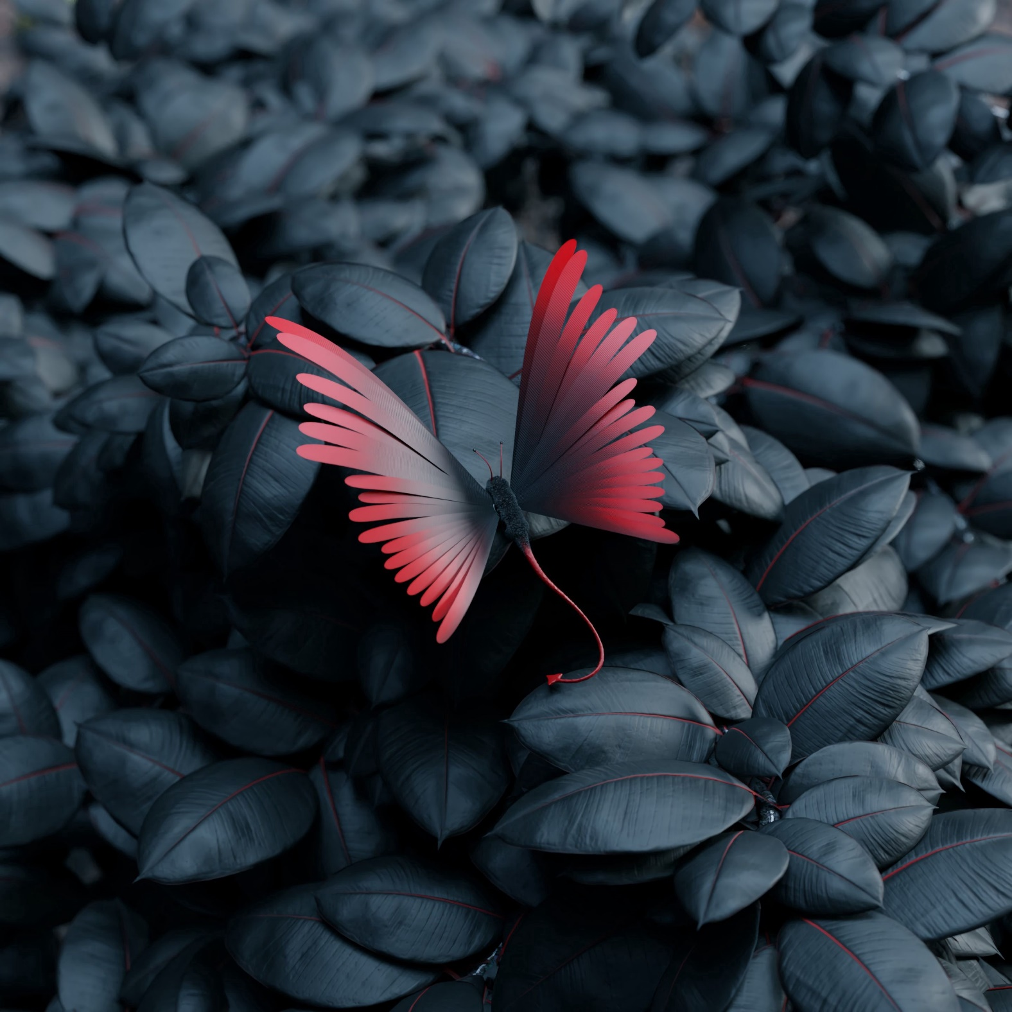

Dear
Dear
From
From

Slide 98

Dear
From

Slide 99

Dear
From

Slide 100

Dear
From

Slide 101

Dear
From

Slide 102

Dear
From

Slide 103

Dear
From

Slide 125

Dear
From

Slide 126

Dear
From

Slide 127

Dear
From

Slide 128


Dear
Dear
From
From

Slide 129

Dear
From

Slide 130

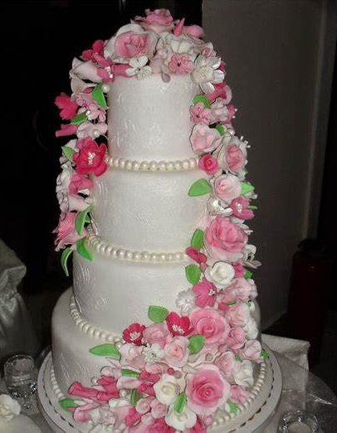
Dear
Dear
From
From

Slide 131


Dear
Dear
From
From

Slide 132
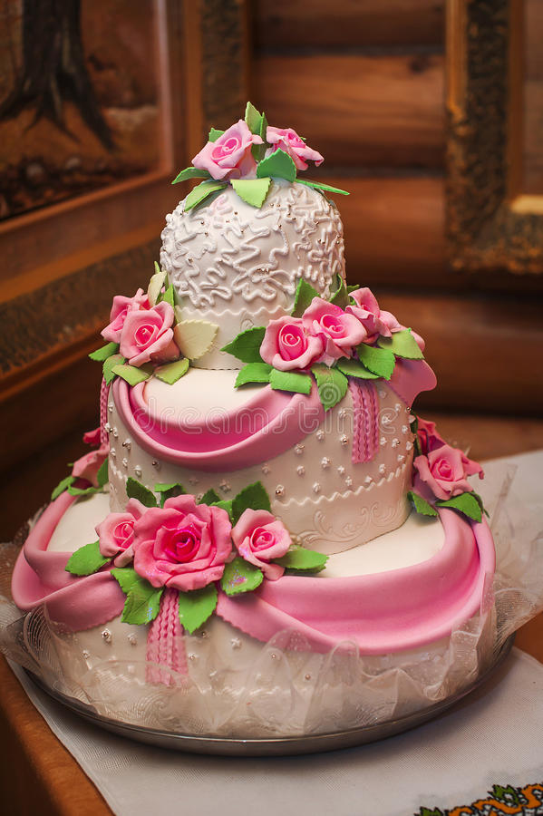
Dear
From

Slide 133
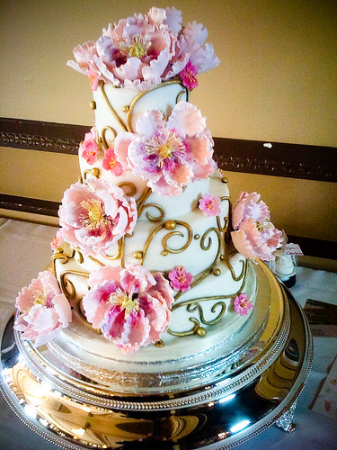
Dear
From

Slide 134
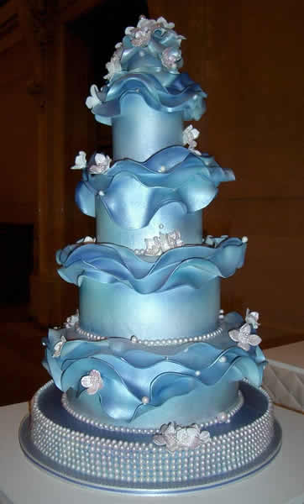
Dear
From

Slide 135

Dear
From

Slide 136

Dear
From

Slide 137

Dear
From

Slide 138

Dear
From

Slide 139
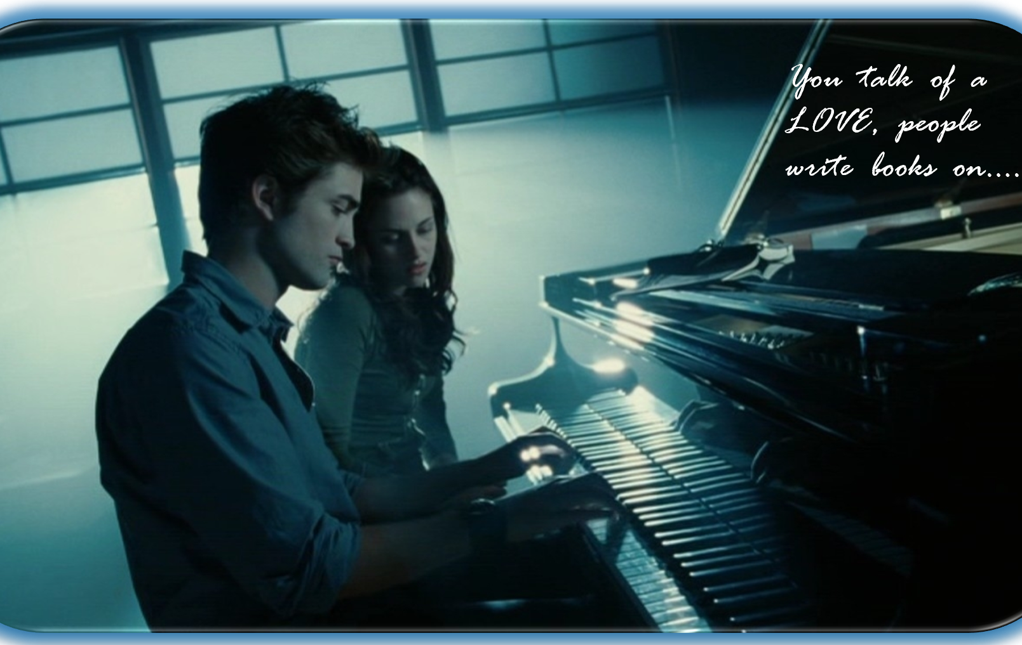
Dear
From

Slide 140

Dear
From

Slide 141

Dear
From

Slide 142

Dear
From

Slide 143
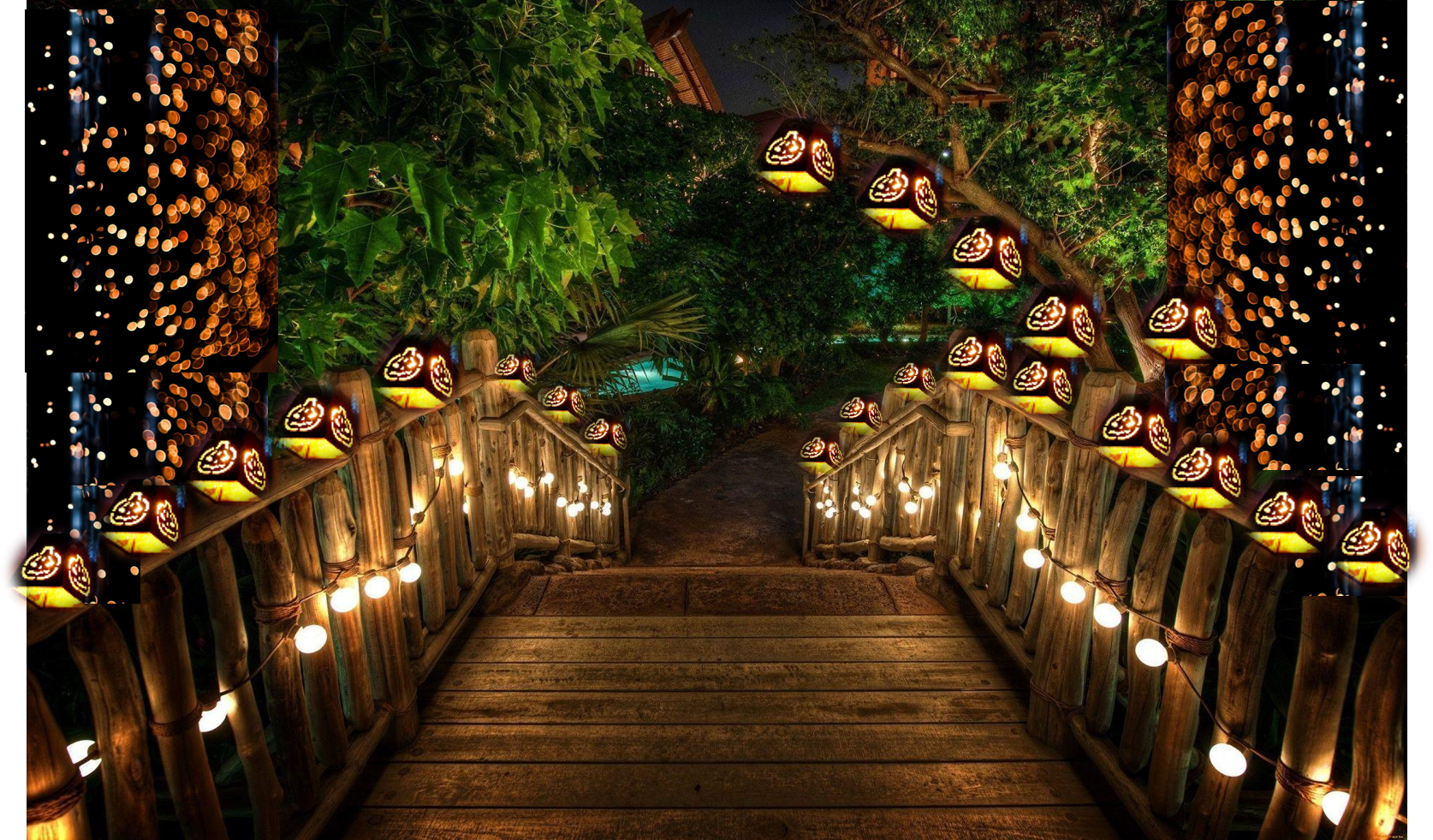
Dear
From

Slide 144

Dear
From

Slide 145
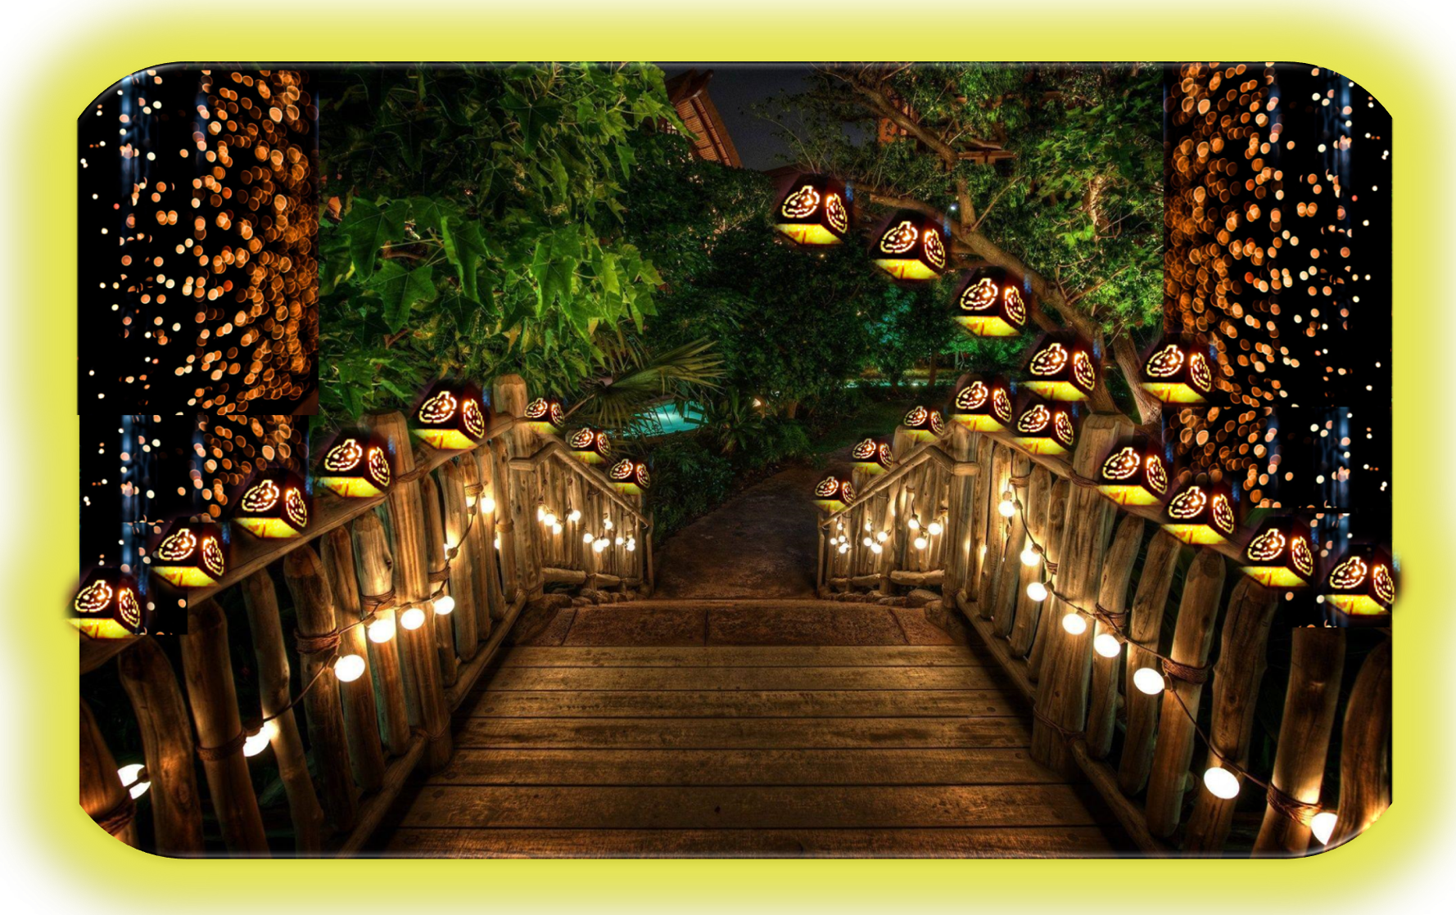
Dear
From

Slide 146

Dear
From

Slide 147

Dear
From

Slide 148
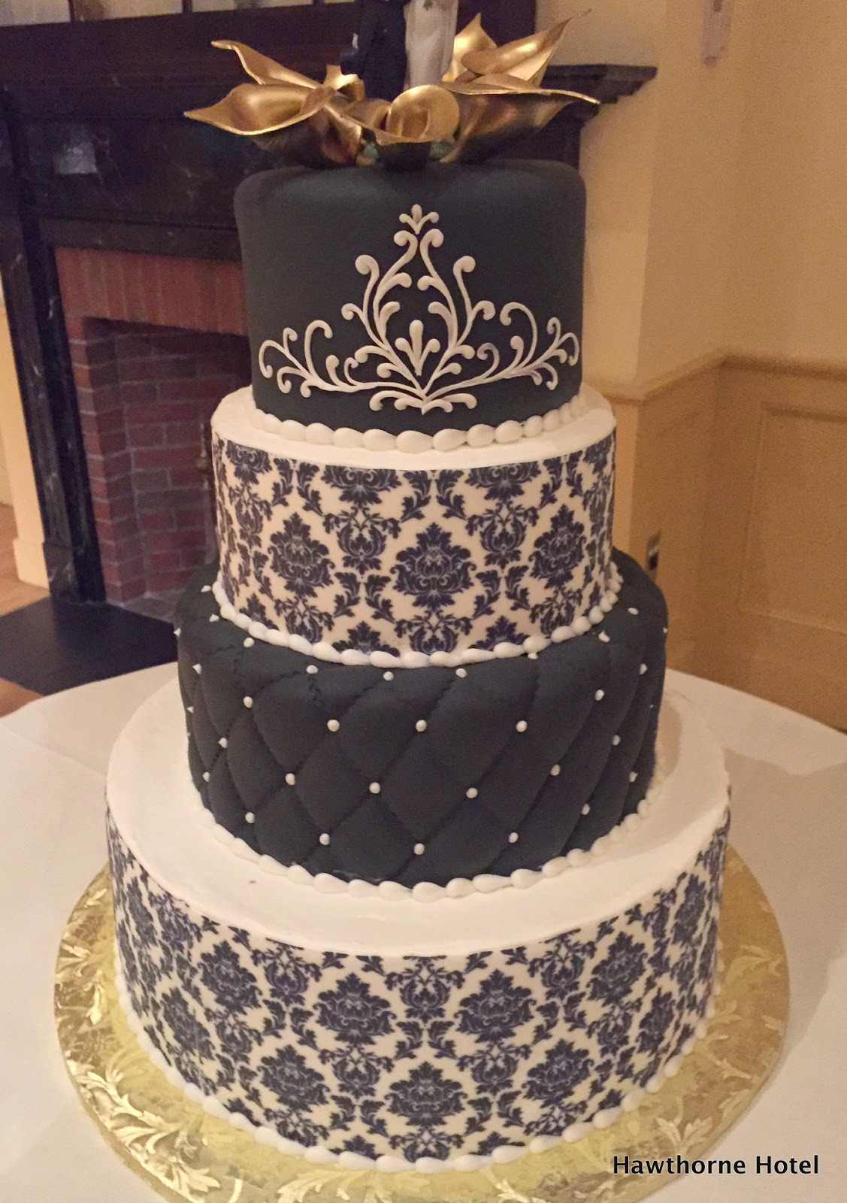
Dear
From

Slide 149

Dear
From

Slide 150

Dear
From

Slide 151

Dear
From

Slide 152

Dear
From

Slide 153

Dear
From

Slide 154

Dear
From

Slide 155

Dear
From

Slide 156
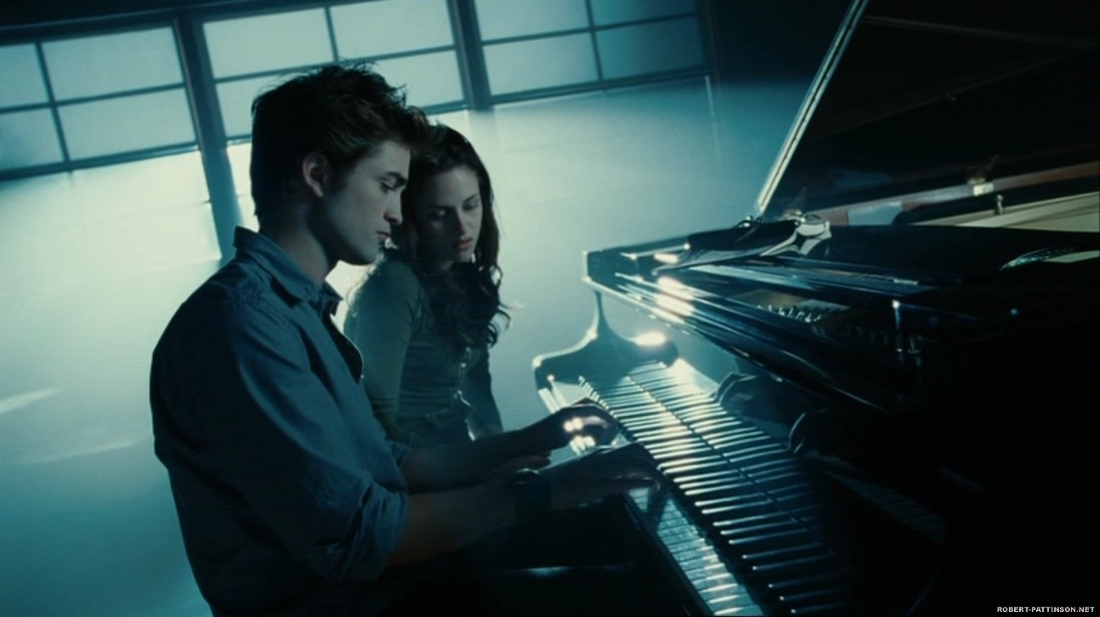
Dear
From

Slide 157

Dear
From

Slide 158

Dear
From

Slide 159
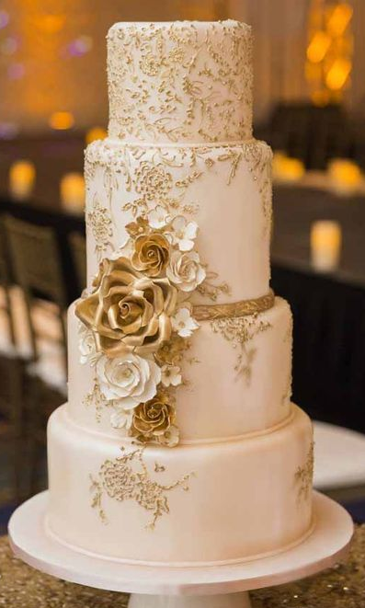
Dear
From

Slide 160

Dear
From

Slide 161

Dear
From

Slide 162
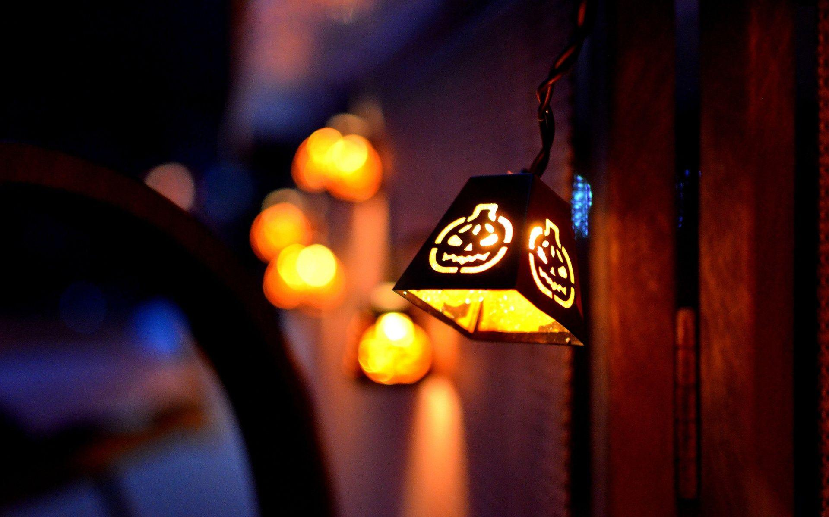
Dear
From

Slide 163

Dear
From

Slide 164

Dear
From

Slide 165

Dear
From

Slide 166

Dear
From

Slide 167

Dear
From

Slide 168
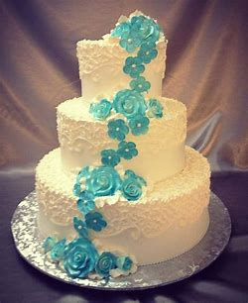
Dear
From

Slide 169
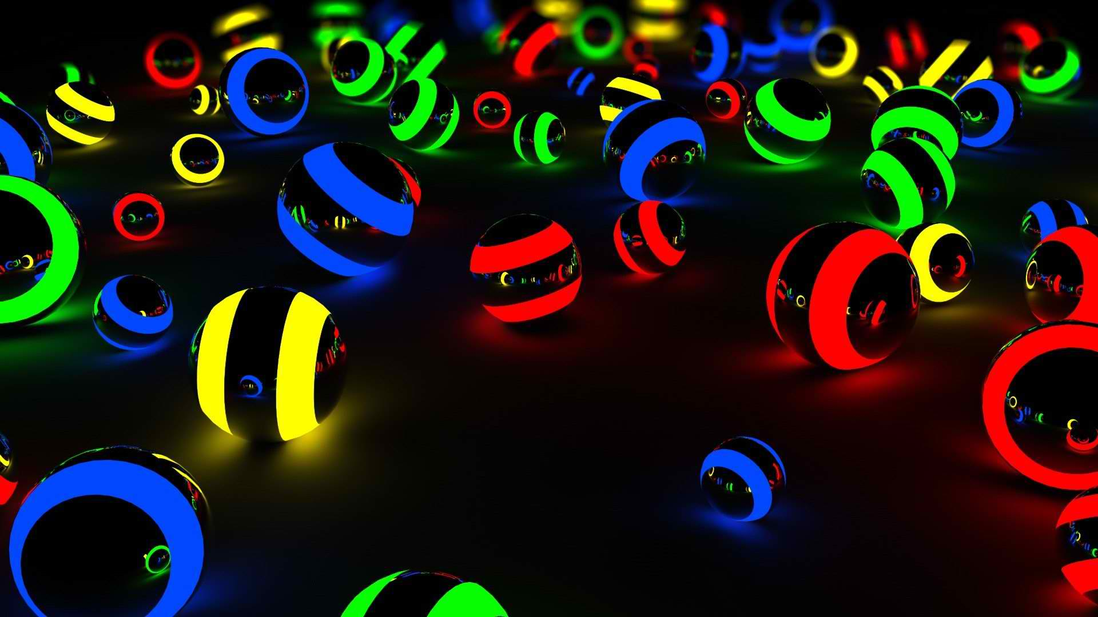
Dear
From

Slide 170

Dear
From

Slide 171

Dear
From

Slide 172

Dear
From

Slide 173

Dear
From

Slide 174

Dear
From

Slide 175

Dear
From

Slide 176

Dear
From

Slide 177

DEAR
From

Slide 178

Dear
From

Slide 179

Dear
From

Slide 180

Dear
From

Slide 181

Dear
From

Slide 182
Dear
From

Slide 183

Dear
From

Slide 184

Dear
From

Slide 185
Dear
From

Slide 186


Dear
From

Slide 187

Dear
From

Slide 188
Dear
From

Slide 189

Dear
From

Slide 190

Dear
From

Slide 191
Dear
From

Slide 192

Dear
From

Slide 193

Dear
From

Slide 194
Dear
From

Slide 195

Dear
From

